Slide 1




Defined benefit pension schemes – What next for Trustees?
12 February 2015

Slide 2
Agenda
    Some key DB statistics
    Funding issues
    Evolving investment strategies
    Assessing company covenant
    Increasing complexity and the growing Governance challenge
    The Standard Transfer Value basis

Slide 3


Some key statistics

Slide 4
Some key DB statistics
 | Number of DB Occupational Pension Schemes 2013/(2012) | Number of active members 2013/(2012) | Approx. assets/liabilities
DB Schemes subject to Funding Standard | 890 / (933) | 178,619 / (189,644) | €50bn assets €55bn Funding Standard liabilities €8bn Funding Standard deficit (liabilities approx. 25% of GDP)
Other data:
  Currently about 750 schemes subject to the Funding Standard
    Implies a significant fall in the number of schemes over 2014
  About 250 schemes with Funding Proposals in place
  About 100 Section 50s to date many with Funding Proposals also
  35 schemes with no Funding Proposal/Section 50 in place

Slide 5
Funding Issues

Slide 6
The funding crisis just won’t go away
Key issues are:
    Bond yields keep falling offsetting investment gains
    Catastrophic accounting number at 31/12/2014 for some sponsors
    Very low return expectations will make Funding Proposal ‘on-track’ assessments challenging
    Fundamental instability in the statutory funding system remains
    Risk reserves in from 1/1/2016
    Combining a long term perspective with shorter term Funding Standard requirements is difficult

Slide 7
Evolving investment strategies

Slide 8
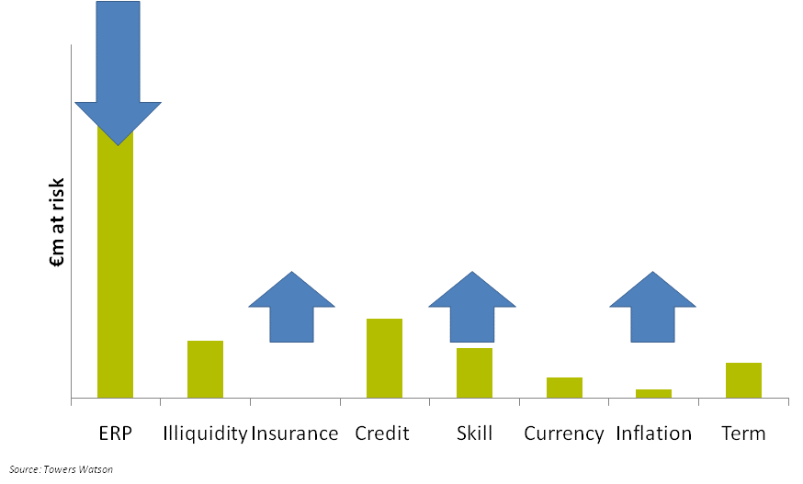
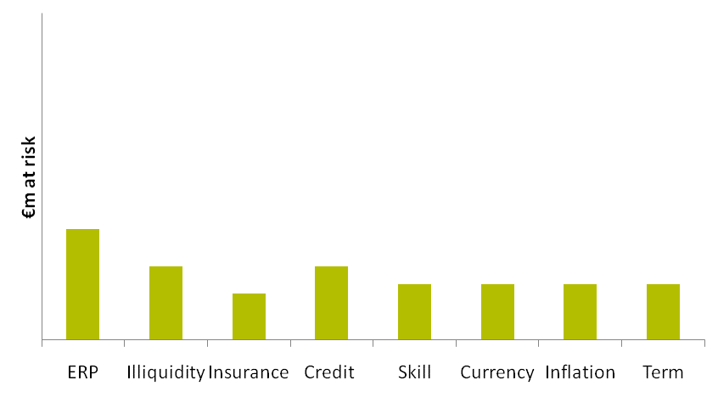
Portfolio construction and manager structure
Diversification

Slide 9
Consider long-term investment objectives
The ‘Journey Planning’ concept
Funding level
100% funded on a self-sufficiency basis
€m
Journey Plan
Future investment
outperformance
Company contributions
Current position
Existing assets
0
...but also need to consider the potential for bad outcomes (risk)
Liabilities
Paid from...
Time
    Key questions Possible answers / considerations
    Where do you want to get to 100% funded on an MFS basis? 100% funded on a bond basis? Include additional margin for prudence (demographic / mortality risk?)
    When do you want to get there? Sooner is preferable, but what is affordable? A shorter timeframe will require a higher outperformance target. How mush risk is acceptable along the way?
    How do you want to get there? What mix of contributions and investment outperformance? Targeting higher investment outperformance means a greater risk of a fall in funding level.
    What will you do if you don’t get there? Ask the Company for more money? Take more investment risk? Extend the timeframe?

Slide 11
Assessing Company Covenant

Slide 12
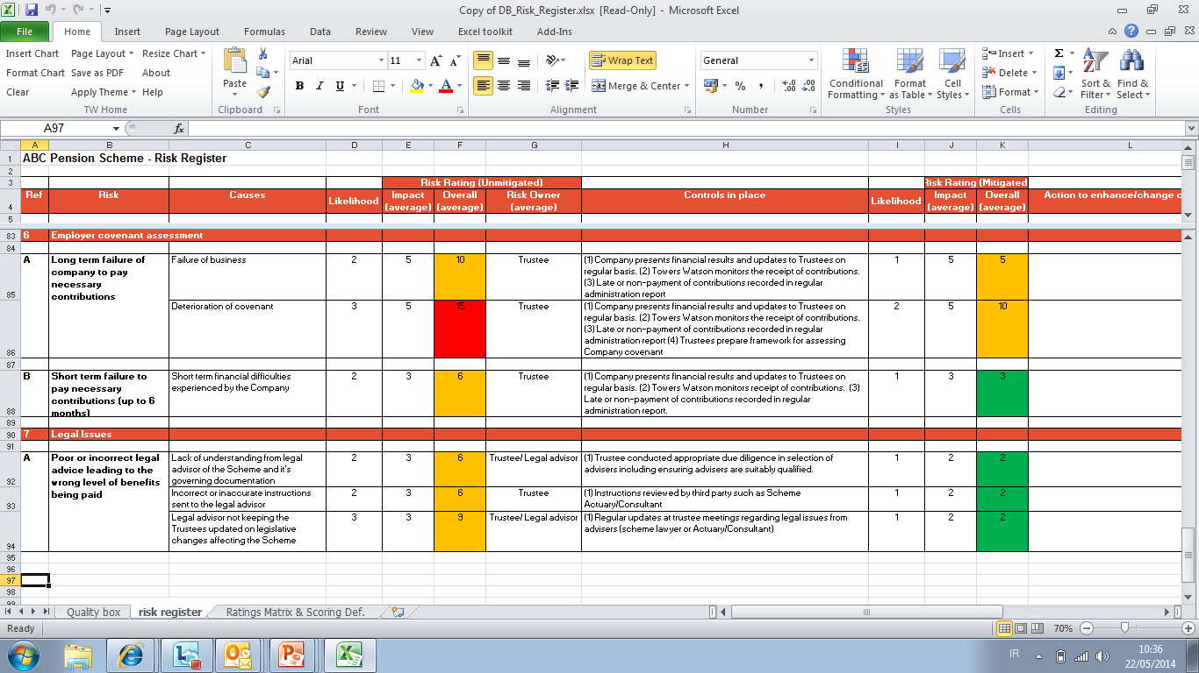
Diminishing Company covenant – biggest single DB risk?

Slide 13
Increasing complexity and the growing Governance challenge

Slide 14
Increasing Complexity
New legislation rarely if ever simplifies things, tends to add additional layers of complexity
Benefit changes have made administering and communicating schemes much more complicated and expensive
Closure to future accrual requires an integrated approach to administering benefits for a legacy DB arrangement and also a new DC structure
Revenue rules and preservation requirements need a radical overhaul
‘Decision tree’ at retirement has become very complex
Deferred member data becoming increasingly out of date and difficult to administer
Need for ‘data cleaning’ as schemes mature

Slide 15
Pensions Authority consultation on financial management guidelines
    Pensions Authority has issued draft guidelines on financial management of defined benefit schemes
    Guidelines cover:
    Scheme data the trustees should have available to them
    Governance practices relevant to financial management
    Processes that the trustees should follow
    Analysis that the trustees should undertake in order to arrive at decisions
Guidelines emphasise that trustees should ensure they have access to actuarial and investment advice
Consultation period finished 30 September 2014
Pensions Authority reflecting on the consultation and final guidelines due shortly

Slide 16
Pensions Authority consultation on financial management guidelines
Scheme data
Asset values and returns
Asset allocation relative to benchmark
Scheme liabilities and solvency position and progress v Funding Proposal
Costs compared to budget
All information provided at least annually
Processes
Review of investment strategy
Review of contribution and funding adequacy
Preparation/review of risk matrix
Discussion with employer about contributions and related issues
Review of investment manager performance
Review of scheme costs
Governance
Regular scheduled and structured Trustee Meetings
Delegation of functions, monitoring of advisers
Management of conflicts
Monitoring of costs and agreement with sponsor
Written SIPP
Analysis
Are the scheme contributions adequate to provide the benefits of the scheme in the short and long term?
How likely is it that the benefits cannot be paid because of the risks to which the scheme is subject?

Slide 17
The Transfer Value basis

Slide 18
Standard Transfer Value basis
Trustees of well funded pension schemes beginning to re-consider use of standard transfer value basis:
      Assumptions have not been updated for a long time, no longer market related
      Offers very poor value for transferees
      Link to actuarial value is weak
      Will depend on wording under Trust Deed and Rules

