Slide 1
Life \ Pensions \ Investments
Master Trusts – A Pensions Panacea?
IAPF - 19 Oct 2021
Shane O’Farrell
Director of Products Irish Life Corporate Business

Slide 2
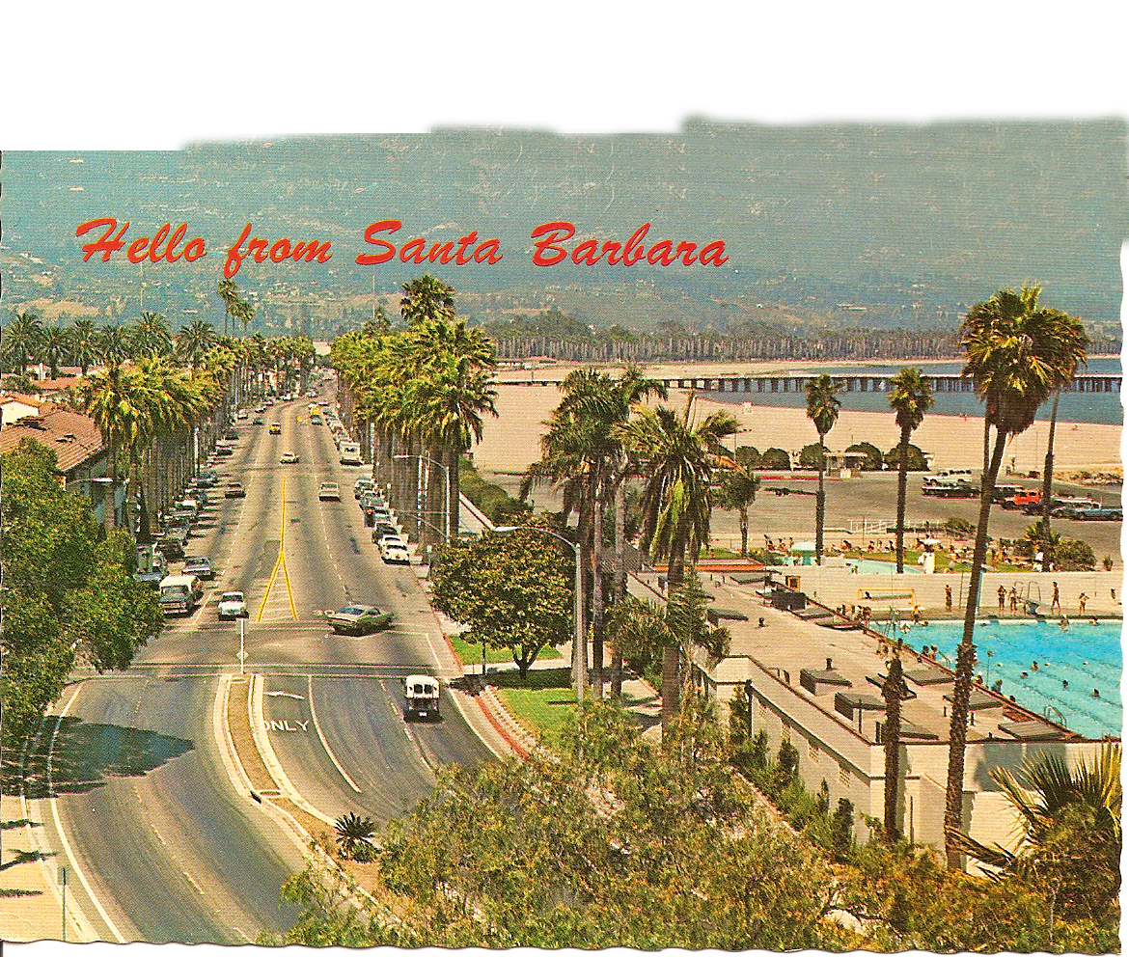
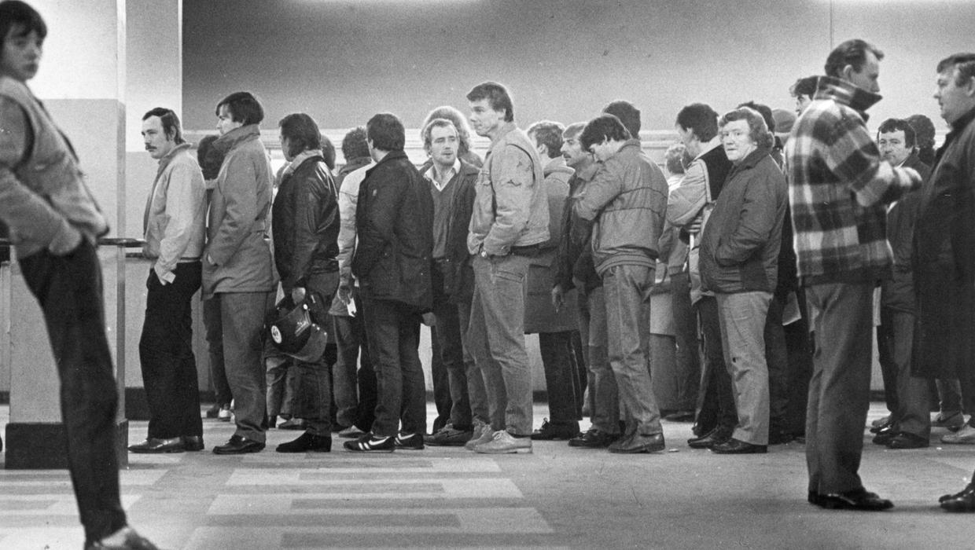
Push and pull factors
Helping people build better futures
Helping people build better futures
Push and pull factors
A lesson from an old geography teacher, in 1980’s Dublin
2
2

Slide 3
Push and pull factors
Ireland
Helping people build better futures
Helping people build better futures
Push and pull factors
Ireland 1980’s
California 1980’s
Ireland
3
A lesson from an old geography teacher, in 1980’s Dublin

Slide 4
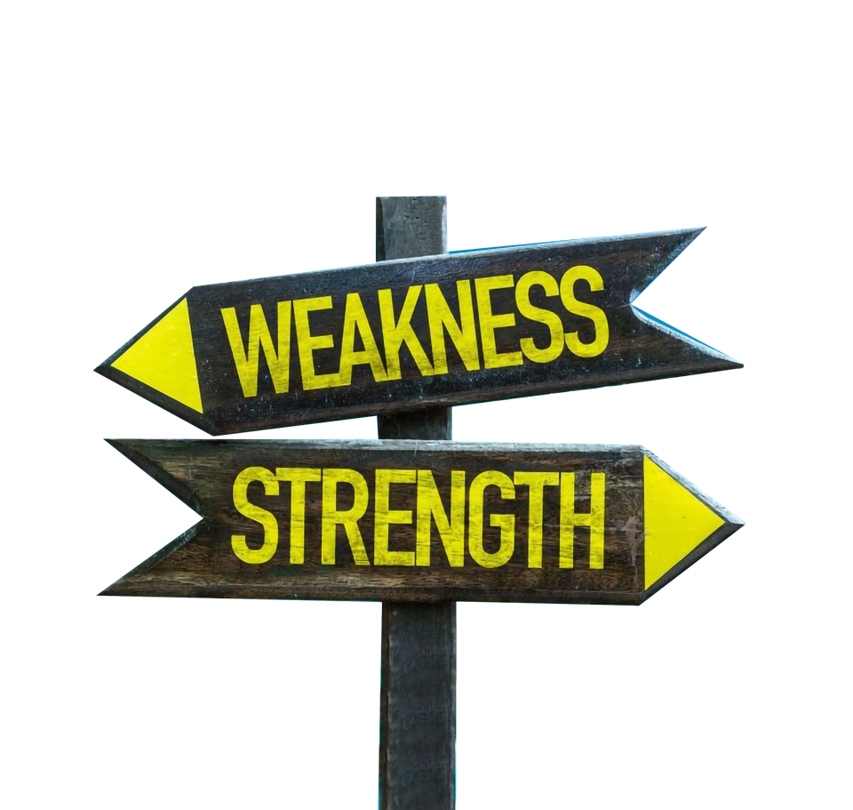
The Push & Pull of Master Trust
Helping people build better futures
The Push & Pull of Master Trust
Master Trusts it’s a similar situation: portrayed by some as a panacea to all pension ills over traditional trusts. There are features that are inherently strong in them and others factors that are weaknesses in other models; but other considerations also come into it.
Note: PRSA’s are not currently fit for purpose in group situation so excluded
So, it’s really critical to break this analysis into different scenarios….
4

Slide 5
Helping people build better futures
Scenario 1: Master Trusts v Stand Alone schemes from a green field site perspective
Imagine there’s a new FDI company setting up today in Ireland - with no legacy issues - so they can objectively look at all options. Which model would they choose?
Or rather - as it’s not always A over B - what philosophy would the new co FDI need to choose master trusts over Stand Alone trusts or vice versa?
5

Slide 6
Helping people build better futures
Scenario 2: Legacy Employers in Standalone, Single Trusts
They have an additional consideration in any assessment: the hurdle that they need to face to move from one to another.
And that hurdle appears to be a challenging one, but also of uncertain and varying height right now.
Will discuss this hurdle issue for legacy company later.
6

Slide 7
Helping people build better futures
Very old and very new
MTs are in the unique position of being very old and very new: they simply took a break there for 25+ years.
There have been multi-employer schemes in the past for certain industries. The printer and newspaper industries had amalgamated schemes where rates and T&CS were agreed by a central process and all members contributed to the one central scheme. Construction industry today.
Very challenging for DB - with different employers having different levels of strength and commitments to them.
Focus here is on DC
7

Slide 8
Helping people build better futures
International perspective
Irish Life has done some extensive research internationally included visiting New Zealand (pre COVID) and a (virtual) UK tour in 2021 on master trusts
In UK, MT now the dominant form of provision for new money and new flows
NEST, State backed Auto Enrolment provider, is a Master Trust
Significant consolidation since the Regulator introduced very stringent approval process
Down from over 80 to about 30 and expected to shrink more
Now over 12m Actives and 10m Deferred members in UK MTs (Auto Enrolment is a major driver)
Very well established in Australia and New Zealand
Master Trust suited for an Irish Auto Enrolment model?
8

Slide 9
Helping people build better futures
Master Trusts in 2021
Governance
Stand Alone
V’s
Master Trust
Let’s compare the two models side by side…
One trust per employer
Benefit Design
Stand Alone | V’s |  | Master Trust
Full flexibility |  |  | Still full flexibility per employer (eg each employer has own contribution rates)
Comment
Important to note a MT is not a one size fits all: different contribution rate designs can all be accommodated inside the one big tent (including any legacy rates from prior schemes).
Comment
MT model has great advantage of scale and cost efficiency; but trustees may be more distant from members and understand each group of member’s needs less
9

Slide 10
Helping people build better futures
Master Trusts in 2021
Governance
Stand Alone
V’s
Master Trust
Let’s compare the two models side by side…
One trust per employer
Governance
Stand Alone | V’s |  | Master Trust
One trust per employer |  |  | One trust for many employers
Comment
MT model has great advantage of scale and cost efficiency; the hefty costs of IORP2 are borne by a much bigger entity; cost of Risk Manager and Internal Audit spread over 1000s of members. Trustees will be more professional and engaged. The PA will regulate very closely. But trustees may be more distant from members and understand each group of member’s individual needs less. MT less likely to have lay trustees with the pros and cons that brings.
Comment
MT model has great advantage of scale and cost efficiency; but trustees may be more distant from members and understand each group of member’s needs less
10

Slide 11
Helping people build better futures
Master Trusts in 2021
Governance
Stand Alone
V’s
Master Trust
Let’s compare the two models side by side…
One trust per employer
Charges and expenses
Stand Alone | V’s |  | Master Trust
Each scheme is stand alone |  |  | Size still a factor but all participating plans will benefit from economies of scale
Comment
Expenses will be a big saving for smaller schemes – the costs of compliance with the new IORP II regulations will be simply be too much for many smaller and medium sized plans to absorb as standalone plans. But some larger schemes may tolerate this.
Comment
MT model has great advantage of scale and cost efficiency; but trustees may be more distant from members and understand each group of member’s needs less
11

Slide 12
Helping people build better futures
Master Trusts in 2021
Governance
Stand Alone
V’s
Master Trust
Let’s compare the two models side by side…
One trust per employer
Employer Brand/Identity
Stand Alone | V’s |  | Master Trust
Employer has more control over scheme name, fund names etc |  |  | Employer is more distant: eg it’s the EMPOWER Master Trust ACME Plan rather than the ACME Pension Plan and ACME Growth Fund
Comment
This can be good and bad: less employer branding and ‘kudos’, but also less work required and lower exposure to any regulations failing or other gaffes. By working with provider the employer can still ensure their contribution is valued by staff but need to think differently on achieving this. The employer can re-direct their governance resources into more genuine staff engagement.
Comment
MT model has great advantage of scale and cost efficiency; but trustees may be more distant from members and understand each group of member’s needs less
12

Slide 13
Helping people build better futures
Master Trusts in 2021
Governance
Stand Alone
V’s
Master Trust
Let’s compare the two models side by side…
One trust per employer
Member Engagement
Stand Alone | V’s |  | Master Trust
All communications (and entire scheme) can be tailored for the employer |  |  | Need to ensure employer specific comms are on offer: whilst one size fits all ticks compliance, not really effective
Comment
One angle is that the MT frees up employer time to focus on the meaningful engagement and not the less valuable governance tasks which are left to experts. Whilst some governance detail will be at the master trust generic level, employer and provider can also tailor comms to specific employer plans within the wider MT scheme.
Comment
MT model has great advantage of scale and cost efficiency; but trustees may be more distant from members and understand each group of member’s needs less
13

Slide 14
Helping people build better futures
Master Trusts in 2021
Governance
Stand Alone
V’s
Master Trust
Let’s compare the two models side by side…
One trust per employer
Scenario 2/legacy issue
Industrial Relations/Union issues re change
Stand Alone | V’s |  | Master Trust
How credible is another change? |  |  | Will be new and involve employee engagement
Comment
If the Stand Alone DC is only set up in recent years after maybe a complex DB exit, there may be limited appetite to open up another pension change right now (albeit a relatively technical one). There may be a “cooling off” period required before there’s any appetite for pensions debate.
Comment
MT model has great advantage of scale and cost efficiency; but trustees may be more distant from members and understand each group of member’s needs less
14

Slide 15
Helping people build better futures
So, how will new plans decide?
In the end, it comes down to personal preference.
The FDI going for the Master Trust could justify it on these grounds:
Company A
I want to reward my employees and have competitive benefits……
….but I don’t want the hassle or risks of getting involved in this complex pensions world. I want professionals to look after that and we can focus on our business secure in the knowledge that our staff are looked after.
The FDI next door might justify their decision to go for a Stand Alone Trust:
Company B
I want to reward my employees and have competitive benefits……
……but I want the company to get maximum kudos for that. Our employees have unique needs and we want to be fully involved in controlling the plan to meet these as best we can and ensure we attract/retain talent.
15

Slide 16
Does MT competition differ to standard provider competition?
Helping people build better futures
The usual factors apply including:
standards of service
counterparty/security
investment funds offering and lifestyling
member communication tools
all in pricing model or baseline plus fees etc
16

Slide 17
Does MT competition differ to standard provider competition?
Helping people build better futures
Uniquely under Master Trust extra factors apply:
Trustee model:
Who are the trustees and are they independent of the provider and/or their wider organisation? Need a degree of separation and challenge
Employee engagement:
Employers have a lesser formal role and Employees are more distant from decision makers: how are employees engaged and empowered? One size does not fit all
Defaults:
MT cannot be all thing to all people-need a degree of standardisation: how good and sophisticated is that core offering for medium plans? Has to be best in class as the core offering regarding lifestyling, range of funds etc
Inclusion of Life Cover (Risk Benefits):
Does the MT allow risk benefits under it or not? Convenient to employer if they are allowed under the same trust and may create some bundling efficiency
17

Slide 18
Consumers are not particularly informed about sustainability beyond the personal action they can take
Helping people build better futures
So, how will new plans decide?
The bottom line?
Of course the statements for Stand Alone and Master Trusts could be phrased in negative, more biased ways too!
In reality, when the costs of IORP II are accounted for, I’d expect far more newer companies to choose the Master Trust model than Stand Alone.
Existing schemes are much more debatable….let’s go back to that hurdle…
18

Slide 19
Helping people build better futures
Now imagine the decision to move is made… what happens next? Back to the hurdle…
Let’s consider the employer journey for a minute.
An established employer with a legacy traditional trust scheme has done the active assessment of the pros and cons and decided they want to move to master trust.
Their next concern: how painful is the journey likely to be?
19

Slide 20
Helping people build better futures
Now imagine the decision is made… what happens next?
This is an area of heated debate and there are calls for legislation to smooth the process.
Current regs were not designed for this “upgrade to Master Trust scenario” and need review.
20

Slide 21
Consumers are not particularly informed about sustainability beyond the personal action they can take
Helping people build better futures
The Irish Life viewpoint
Our view in Irish Life - and one we have documented clearly in our response to the Pension Authority IORP II draft guidance consultations - is that the end members’ interests and experience must be paramount on this journey.
Members must not be needlessly worried or concerned by any changes (especially largely technical ones that are ultimately being done for their greater good).
We are concerned that a bumpy journey from A to B will cause members to question their pension scheme, lose confidence in its security and may actually reduce pension coverage and quality. This must be avoided at all costs.
Members will be told twice that their pension plan is “shutting down”, when in reality it should simply be a technical ‘under the bonnet’ kind of change: need re-assuring message
21

Slide 22
Helping people build better futures
Challenges we are developing solutions to
GDPR The migration of data between trusts
Fund and Strategy consistency Are the same funds available with the master trust as the old plan? The existing ones may even be dated and the change a welcome upgrade, but this still triggers a ‘change’ communication
Access to web portals and apps Is access to all of these features going to be seamless and continuous, or will members need to re-set/re-register/start over?
22

Slide 23
Helping people build better futures
Challenges we are developing solutions to
Deferred members
These need special consideration. If a plan transfers to a master trust, the deferred member may cease to have any relationship with the employer and instead become a deferred member of the wider master trust. What impact will that have?
23

Slide 24
Helping people build better futures
Critical considerations
It’s absolutely critical that all these issues are thoughtfully considered and a project plan developed.
It’s also critical that there is a good working relationship between the employer and the existing/former trustees.
Of course, the provider/advisor needs to ensure the whole project hangs together, ensuring member security, confidence and protection. Irish Life’s strong view is good member experience is paramount.
24

Slide 25
Helping people build better futures
Conclusion
Master Trusts not a panacea but are a very credible option for new set ups
International evidence supports that they deliver generally high governance standards and good outcomes
Will likely be the lifeboat of choice for small to medium sized corporate plans when the IORP2 costs bite
More varied outcomes expected in the larger to mega space
Transition challenges exist and need careful consideration
Good luck in your considerations!
25

Slide 26
Thank You
Irish Life Assurance plc is regulated by the Central Bank of Ireland.
Irish Life Assurance plc, Registered in Ireland number 152576, VAT number 9F55923G.
Irish Life Health dac is regulated by the Central Bank of Ireland.
7787cb (NPI 10-21)

